Slide 1
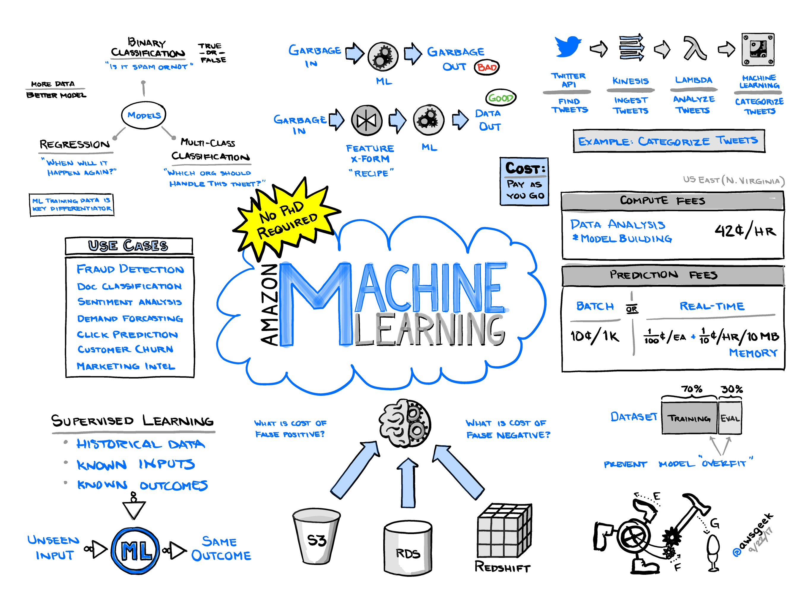

Machine Learning Model Development Report
Project Overview :-
This report outlines the development process of a machine learning model aimed at predicting a specific target variable ('s.s.temp.') using a dataset provided in 'train.csv'. The model employs a Decision Tree Regressor and includes necessary data preprocessing steps to ensure reliable and accurate predictions.
ThePhoto by PhotoAuthor is licensed under CCYYSA.
Steps in Model Development :-
Data Loading and Initial Exploration
Data Splitting
Pipeline Preparation
Model Training
Model Evaluation

Slide 2

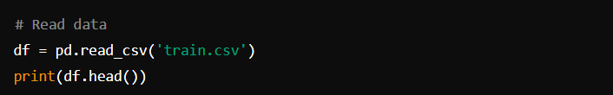
Data Loading and Initial Exploration
Objective:-
To load the dataset and perform initial exploration to understand its structure and content
Code:-
Detail:-
The dataset is loaded using the pandas library.
Initial exploration is done using 'print(df.head())' to display the first few rows of the dataset.

Slide 3
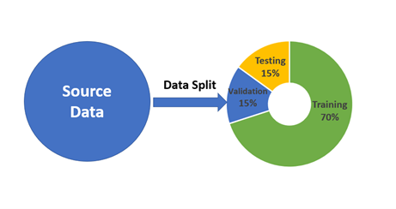
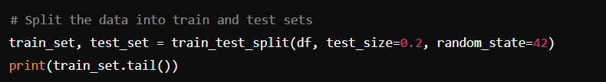
Data Splitting
Objective:-
To split the dataset into training and test sets to facilitate model training and evaluation.
Code:-
Detail:-
The dataset is split into training and test sets using an 80-20 split ratio.
'random_state=42' ensures reproducibility of the split.

Slide 4
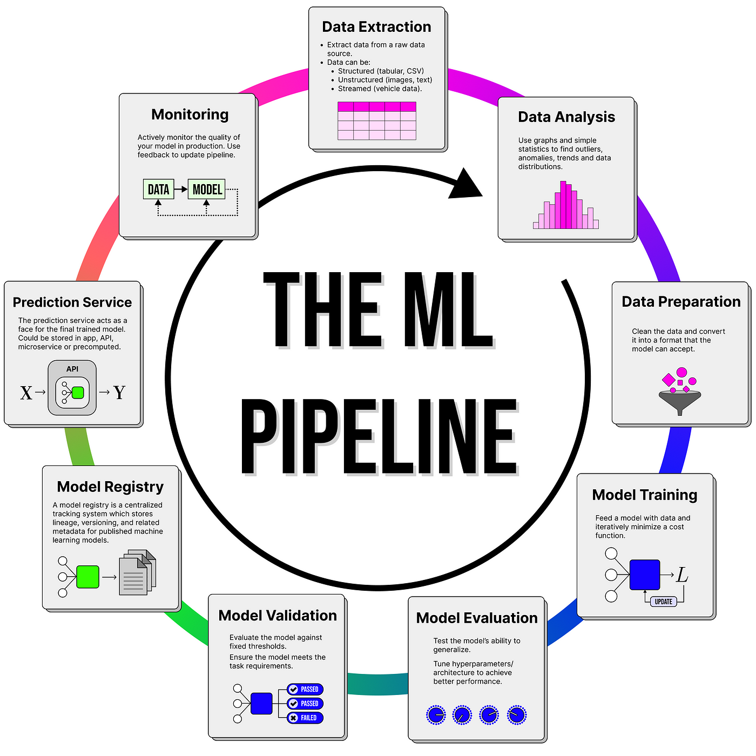
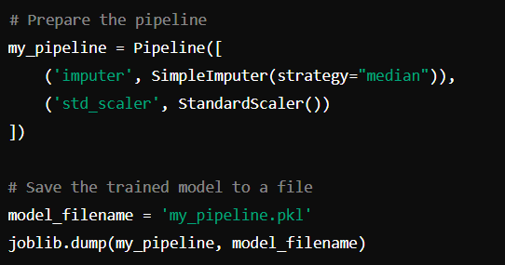
Pipeline Preparation
Objective:-
To prepare a data preprocessing pipeline that handles missing values and scales the features.
Code:-
Details:-
The pipeline includes SimpleImputer to handle missing values using the median strategy and StandardScaler to standardize the features.
The pipeline is saved using joblib for future use.

Slide 5
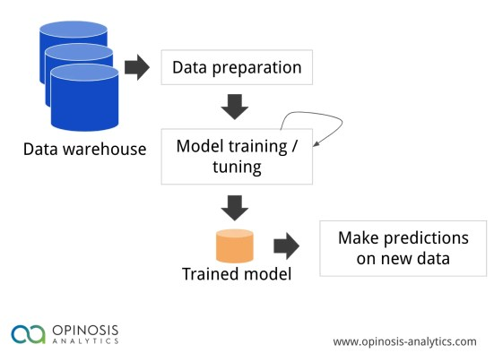
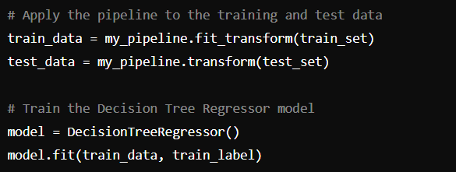
Model Training
Objective: -
To train a Decision Tree Regressor model using the preprocessed training data.
Code:-
Details:-​
Features and labels are separated for both training and test sets.​
The pipeline is applied to both training and test data to ensure consistent preprocessing.​
A Decision Tree Regressor model is trained using the preprocessed training data.​

Slide 6
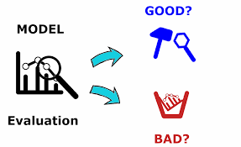
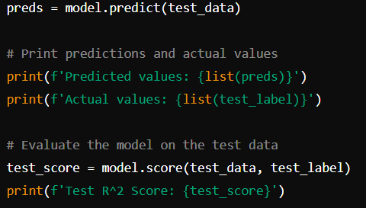
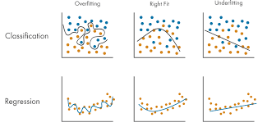
Model Evaluation
Objective:-
To evaluate the model's performance using the test data.
Code:-
Details:-
Predictions are made on the test data.
Predicted values and actual values are printed for comparison.
The model's performance is evaluated using the R² score on the test data.

Slide 7

Conclusion:-
A Decision Tree Regressor was trained on preprocessed data, capturing complex relationships and ensuring effective model learning.
The dataset was split and preprocessed using a pipeline to ensure consistency and reliability, handling missing values and standardization.
The model's performance was evaluated on test data, using predicted values and the R² score to assess accuracy and realism.
The preprocessing pipeline and trained model were saved with 'joblib', ensuring they can be reused consistently in future applications.
The model's predictions closely matched actual values, demonstrating its effectiveness and reliability in real-world prediction scenarios.

